Slide 1

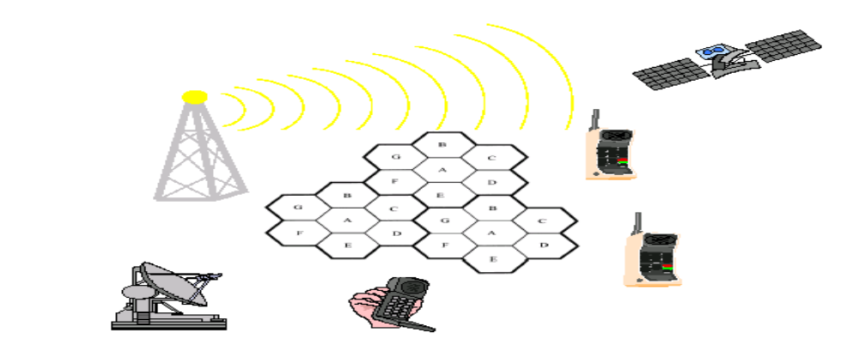
Chapter Two
Multiple access technique for Cellular communication

Slide 2
Main topics
Hidden and Exposed Terminals
Far and Near Terminals
Access Methods
      FDMA
      TDMA
      CDMA
      OFDMA

Slide 3
Media Access
Can we apply media access methods from fixed networks?
Example CSMA/CD
    Carrier Sense Multiple Access with Collision Detection
    send as soon as the medium is free, listen into the medium if a collision occurs (legacy method in IEEE 802.3)
Problems in wireless networks
    Signal strength decreases proportional to the square of the distance.
    The sender would apply CS and CD, but the collisions happen at the receiver
    It might be the case that a sender cannot “hear” the collision, i.e., CD does not work
    Furthermore, CS might not work if, e.g., a terminal is “hidden”

Slide 4
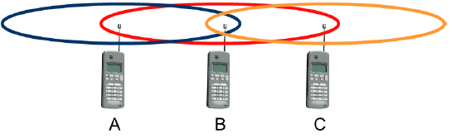
Hidden and exposed terminals
Hidden terminals
    A sends to B, C cannot receive A
    C wants to send to B, C senses a “free” medium (CS fails)
    Collision at B, A cannot receive the collision (CD fails)
    A is “hidden” for C
Exposed terminals
    B sends to A, C wants to send to another terminal (not A or B)
    C has to wait, CS signals a medium in use
    but A is outside the radio range of C, therefore waiting is not necessary
    C is “exposed” to B

Slide 5
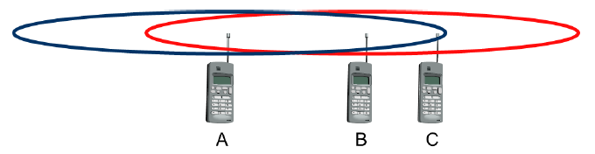
Near and far terminals
Terminals A and B send, C receives
  signal strength decreases proportional to the square of the distance
  the signal of terminal B therefore drowns out A’s signal C cannot receive A
If C for example was an arbiter for sending rights, terminal B would drown out terminal A already on the physical layer
  Also severe problem for CDMA-networks -precise power control needed!

Slide 6
Multiple access technique
Multiple access is a technique that lets multiple mobile users share the allotted spectrum in the most effective manner.
Describes how several users can share a medium with minimum or no interference.
    Example, high ways with several lanes.
    Many users (car drivers) use the same medium (the highways) with hopefully no interference (i.e., accidents).
    This is possible due to the provision of several lanes (space division multiplexing) separating the traffic.
    In addition, different cars use the same medium (i.e., the same lane) at different points in time (time division multiplexing).
There are four main multiple access schemes that are used in cellular systems ranging from the very first analogue cellular technologies to those cellular technologies that are being developed for use in the future.
Notes:
Multiple access is a technique that lets multiple mobile users share the allotted spectrum in the most effective manner
. ... In computer networks and telecommunications, the multiple access method permits various terminals to connect to the same multi-point transmission medium to transmit over it and share its capacity.
Why uplink frequency is different from downlink frequency?
In satellite communication, the uplink frequency is higher than the downlink frequency because the attenuation level increase with an increase in frequency. The power at the ground station (Base Station) is more than compared to the power available at the satellite

Slide 7
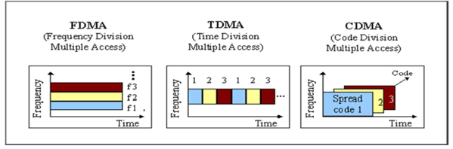
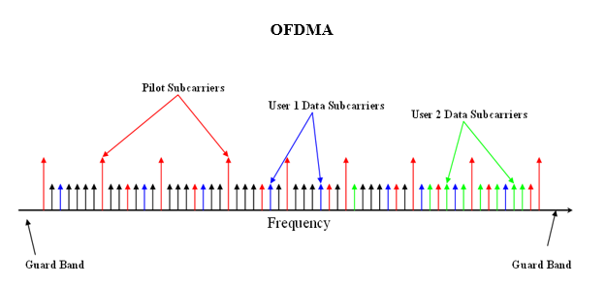
Multiple Access technique…
FDMA
TDMA
CDMA
OFDMA

Slide 8
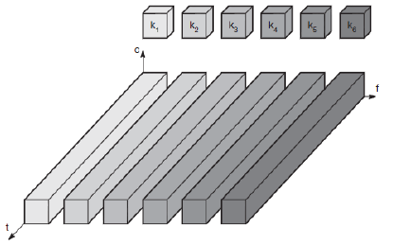
FDMA: Frequency Division Multiple Access
Frequency domain is subdivided into several non-overlapping frequency bands.
Each channel ki is now allotted its own frequency band as indicated.
Senders using a certain frequency band can use this band continuously.
Again, guard spaces are needed to avoid frequency band overlapping (also called adjacent channel interference).
Notes:
Frequency separation b/n forwarding band and reverse band is constants
Two bands of frequency for ever use which is called forward and reverse band is used and require duplexer
Frequency separation between forward band and reverse band is constant
simultaneously and continuously transmitting

Slide 9
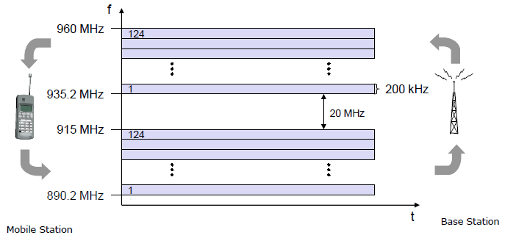
FDMA ….
FDD/FDMA -general scheme, example GSM
The two frequencies are also known as uplink, i.e., from mobile station to base station or from ground control to satellite, and as downlink, i.e., from base station to mobile station or from satellite to ground control.
The basic frequency allocation scheme for GSM is fixed and regulated by national authorities.
All uplinks use the band between 890.2 and 915 MHz, all downlinks use 935.2 to 960 MHz
Notes:
Why uplink frequency is different from downlink frequency?
In satellite communication, the uplink frequency is higher than the downlink frequency because the attenuation level increase with an increase in frequency. The power at the ground station (Base Station) is more than compared to the power available at the satellite

Slide 10
FDMA Contd.
According to FDMA, the base station, shown on the right side, allocates a certain frequency for up-and downlink to establish a duplex channel with a mobile phone.
Up-and downlink have a fixed relation.
  If the uplink frequency is fu= 890 MHz + n·0.2 MHz,
  the downlink frequency is fd= fu+ 45 MHz, i.e., fd= 935 MHz + n·0.2 MHz for a certain channel n.
The base station selects the channel. Each channel (uplink and downlink) has a bandwidth of 200 kHz.
It is a method employed to permit several users to transmit simultaneously on one satellite transponder by assigning a specific frequency within the channel to each user.
      Each conversation gets its own, unique, radio channel.
      The channels are relatively narrow, usually 30 KHz or less and are defined as either transmit or receive channels.
      A full duplex conversation requires a transmit & receive channel pair.

Slide 11
FDMA Contd.
FDM is often used for simultaneous access to the medium by base station and mobile station in cellular networks establishing a duplex channel.
    Mobile station to base station and vice versa are separated using different frequencies.
This scheme also has disadvantages.
    While radio stations broadcast 24 hours a day, mobile communication typically takes place for only a few minutes at a time. Assigning a separate frequency for each possible communication scenario would be a tremendous waste of frequency resources.
    Additionally, the fixed assignment of a frequency to a sender makes the scheme very inflexible and limits the number of senders.
All 1G systems use FDMA

Slide 12
Number of channels in a FDMA system
N=
Bt – 2*B guard
Bc
N … number of channels
Bt … total spectrum allocation
Bguard … guard band
Bc … channel bandwidth
Example: how many total spectrum needed for a system with 100 voice each contains channel of 30KHZ and 10KHZground band ?
Bt=Bc*N+2Bground
100*30KHZ+2(10KHZ)=3020KHZ/1000=30.2MHZ
Notes:
In radio, a guard band is an unused part of the radio spectrum between radio bands, for the purpose of preventing interference

Slide 13
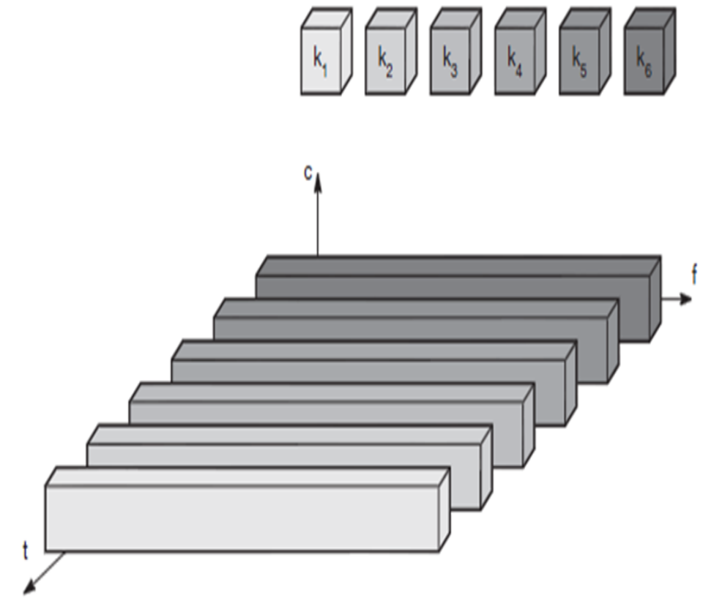
TDMA : Time Division Medium Access
Assigning different slots for uplink and downlink using the same frequency is called time division duplex (TDD,TDMA).
A channel is given the whole bandwidth for a certain amount of time
      All senders use the same frequency, but at different point of time
Synchronization can be done by using
      Fixed Allocation Scheme or
      Dynamic Allocation Scheme
Most of 2G systems use TDMA
Notes:
Multiple users share a single radio channel
forward time slot
reverse time slot
No duplexer is required

Slide 14
Features of TDMA
a single carrier frequency for several users
transmission in bursts
low battery consumption
handoff process much simpler
FDD : switch instead of duplexer
very high transmission rate
high synchronization overhead

Slide 15
Number of channels in a TDMA system
N=
m*(Btot - 2*Bguard)
Bc
N … number of channels
m … number of TDMA users per radio channel
Btot … total spectrum allocation
Bguard … Guard Band
Bc … channel bandwidth
Example :what is the number of channel for a cellular system with allocated spectrum 2MHZ, total band 30KHZ and 1500 KHZ ground band which use 3 reuse factor
N=3(2KHZ*2*1000)-2*1500KHZ = 12000KHZ-3000KHZ/30KHZ= 30
30KHZ

Slide 16
TDMA Schemes
Fixed TDM
Reservation TDMA
      CSMA
      MACA
      ISMA

Slide 17
Fixed TDM
TDM allocates time slots for channels in a fixed pattern.
This results in a fixed bandwidth and is the typical solution for wireless phone systems.
MAC is quite simple, as the only crucial factor is accessing the reserved time slot at the right moment.
If this synchronization is assured, each mobile station knows its turn and no interference will happen.
The fixed pattern can be assigned by the base station, where competition between different mobile stations that want to access the medium is solved.

Slide 18
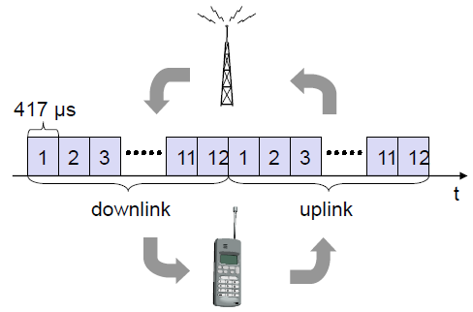
Fixed TDMA: TDD/TDMA -general scheme…
, example DECT
As shown in the figure, the base station uses one out of 12 slots for the downlink, whereas the mobile station uses one out of 12 different slots for the uplink.
Uplink and downlink are separated in time. Up to 12 different mobile stations can use the same frequency without interference using this scheme. Each connection is allotted its own up-and downlink pair.
This general scheme still wastes a lot of bandwidth. It is too static, too inflexible for data communication.
In this case, connectionless, demand-oriented TDMA schemes can be used

Slide 19
MACA ((Multiple Access with Collision Avoidance)
MACA (Multiple Access with Collision Avoidance) uses short signaling packets for collision avoidance
    RTS (request to send): a sender request the right to send from a receiver with a short RTS packet before it sends a data packet
    CTS (clear to send): the receiver grants the right to send as soon as it is ready to receive
Signaling packets contain
    sender address
    receiver address
    packet size

Slide 20
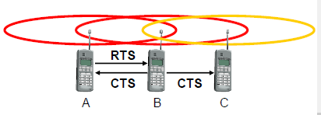
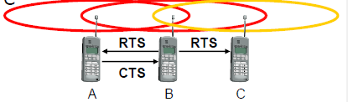
MACA -collision avoidance….
Advantages of MACA
  MACA avoids the problem of hidden terminals
  A and C want to send to B
  A sends RTS first
  C waits after receiving CTS from B
MACA avoids the problem of exposed terminals
  B wants to send to A, C to another terminal
  now C does not have to wait for it, cannot receive CTS from A

Slide 21
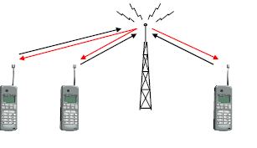
ISMA (Inhibit Sense Multiple Access)
Current state of the medium is signaled via a “busy tone”
  the base station signals on the downlink (base station to terminals) if the medium is free or not
  terminals must not send if the medium is busy
  terminals can access the medium as soon as the busy tone stops
  the base station signals collisions and successful transmissions via the busy tone and acknowledgements, respectively (media access is not coordinated within this approach)
  mechanism used, e.g., for CDPD (USA, integrated into AMPS)

Slide 22
Access method: CDMA
CDMA (Code Division Multiple Access):use of direct sequence spread spectrum
  all terminals send on the same frequency probably at the same time and can use the whole bandwidth of the transmission channel
  each sender has a unique random number, the sender XORs the signal with this random number
  the receiver can “tune” into this signal if it knows the pseudo random number, tuning is done via a correlation function
Disadvantages:
  higher complexity of a receiver (receiver cannot just listen into the medium and start receiving if there is a signal)
  all signals should have the same strength at a receiver
Advantages:
  all terminals can use the same frequency, no planning needed
  huge code space (e.g. 2³²) compared to frequency space
  interferences (e.g. white noise) is not coded
  forward error correction and encryption can be easily integrated

Slide 23
CDMA in theory
Code Division Multiple Access (CDMA) is a sort of multiplexing that facilitates various signals to occupy a single transmission channel.
Sender A
  sends Ad= 1, key Ak= 010011 (assign: “0”= -1, “1”= +1)
  sending signal As= Ad* Ak= (-1, +1, -1, -1, +1, +1)
Sender B
  sends Bd= 0, key Bk= 110101 (assign: “0”= -1, “1”= +1)
  sending signal Bs= Bd* Bk= (-1, -1, -1, -1, -1, -1)
Both signals superimpose in space
  interference neglected (noise etc.)
  As+ Bs= (-2, 0, -2, -2, 0, 0)…
Receiver wants to receive signal from sender A
  apply key Ak bitwise (inner product)
    Ae= (-2, 0, -2, -2, 0, 0) •Ak= 2 + 0 + 0 + 2 + 2 + 0 = 6
    result greater than 0, therefore, original bit was “1”
  receiving B
    Be= (-2, 0, -2, -2, 0, 0) •Bk= -2 + 0 + 0 -2 -2 + 0 = -6, i.e. “0”
Notes:
Reciver 0=-1
AE=AS*common channel =

Slide 24
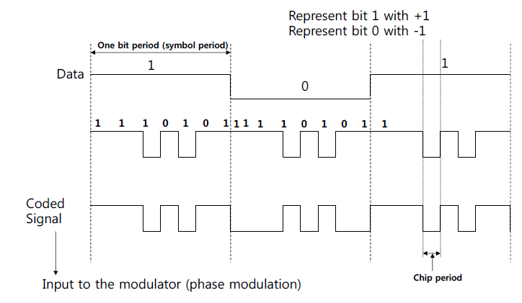
CDMA Principle

Slide 25
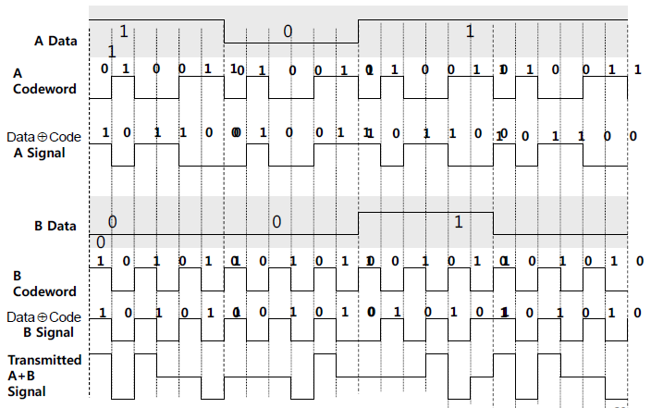
CDMA Example – transmission from two sources

Slide 26
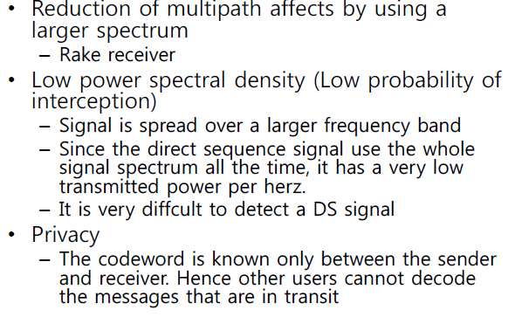
Features of CDMA

Slide 27
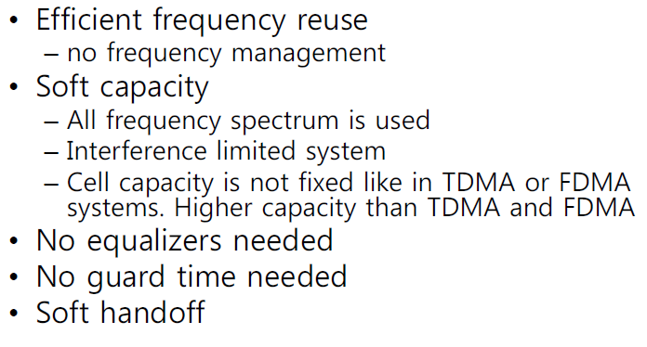
Feature of CDMA….

Slide 28
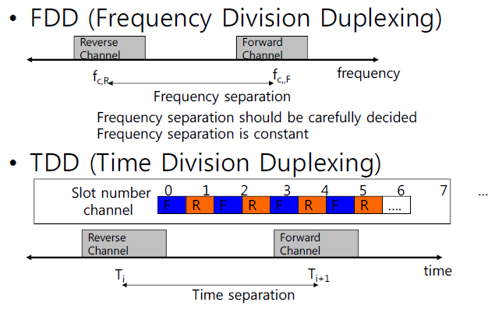
Duplexing/Multiple Access

Slide 29
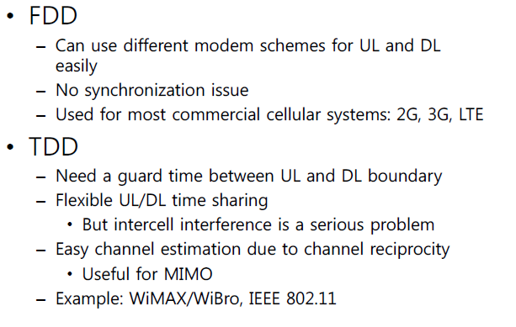
Comparison : FDD vs. TDD
Notes:
From Station to Access point uplink(reverse link)
From AP to Station downlink

Slide 30
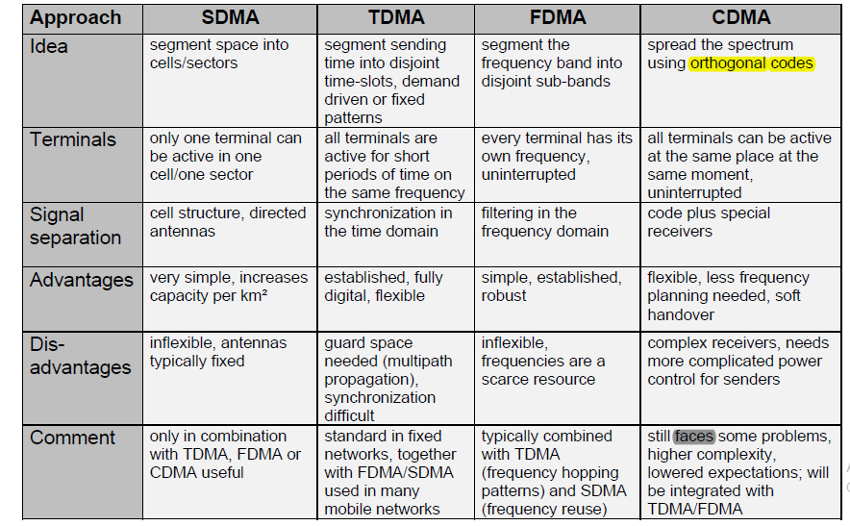
Comparison SDMA/TDMA/FDMA/CDMA

Slide 31
Orthogonal frequency division multiple access(OFDMA)
OFDMA is an updated version of frequency-division multiplexing (OFDM) technology used to divide packets of information into separate bands that are carried by separate signals.
It is a multi-user version of the popular orthogonal frequency-division multiplexing(OFDM)digital modulation scheme.
Multiple access is achieved in OFDMA by assigning subsets of subcarriers to individual users.
This allows simultaneous low-data-rate transmission from several users.
Advantages over OFDM
allows access points to serve multiple clients at the same time
Lower maximal transmission power for low-data-rate users.
Contention-based multiple access (collision avoidance) is simplified.

Slide 32
Adv. of OFDMA…
Further improves OFDM robustness to fading and interference.
Allows per-channel or per-sub channel power.
Higher diversity and efficiency of frequency
Provides lower interference between cells.
More flexibility as channels and sub-channels can be toggled on and off.
Better coverage over networks.

Slide 33
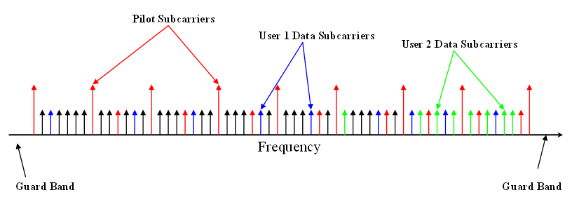
Cont’d…
Disadvantages
Higher sensitivity to frequency offsets and phase noise
The fast channel feedback information and adaptive sub-carrier assignment is more complex than CDMA fast power control.
The diversity of frequencies is conditional on how subcarriers are assigned to users, and can thus become very complex.
Requires extra power because it is always on and ready to send a transmission.
Has a higher sensitivity than other channel types.
Notes:
An example of how OFDMA works is when two phones send data over the same phone line. A time-interval may be assigned to each phone, and they will take turns sending their signal over the line at each assigned interval. However, these time frames are imperceptibly small, making the data transfer seem to happen simultaneously and seamlessly.

Slide 34
Self-Review Questions
1. Compare the following four medium access systems.
(i) SDMA (ii) TDMA (iii) FDMA (iv) CDMA
2. How starvation can be avoided in all multiple access schemes which you have studied. Explain in detail.
3. Define the problem of Hidden and Exposed terminals. What happens in the case of such terminals if Aloha, Slotted Aloha, reservation Aloha or MACA is used?
4. How the reservations improve performance of time based multiple access schemes?

